Slide 1
Fashion Search AI

Slide 2
Objectives
The main objective of this project is to develop a fashion query response system that utilizes AI models to provide detailed and user-friendly responses to fashion-related queries. The system aims to enhance user experience by generating informative and contextually relevant answers, thereby assisting users in finding fashion items based on their preferences.

Slide 3
Design
The project involves two main layers: the search layer and the generation layer. The search layer is responsible for retrieving relevant fashion items from the dataset based on keyword matching or predefined criteria. The generation layer utilizes advanced AI models like GPT-3.5 to generate detailed responses to user queries, incorporating context and generating natural language responses.

Slide 4
Implementation & Data Preprocessing
The implementation involved several steps, including data preprocessing, model integration, and query response generation.
The CSV dataset was formatted to enhance data quality and readability. Blank entries were replaced, decimal points were standardized, and unnecessary columns were removed. Text columns were cleaned to remove HTML tags and extra characters

Slide 5
Model Integration
Advanced AI models like GPT-3.5 were integrated into the system to generate responses to user queries. Queries were passed through the model to generate detailed and contextually relevant responses.

Slide 6
Query Response Generation:
User queries were processed by both the search layer and the generation layer. The search layer retrieved relevant fashion items from the dataset. The generation layer utilized AI models to generate detailed responses to user queries, incorporating context and generating natural language responses.

Slide 7
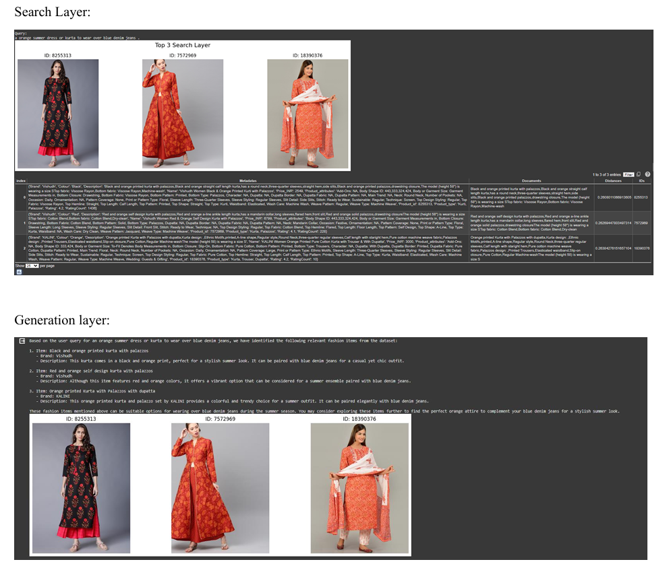
#Query 1: a orange summer dress or kurta to wear over blue denim jeans

Slide 8
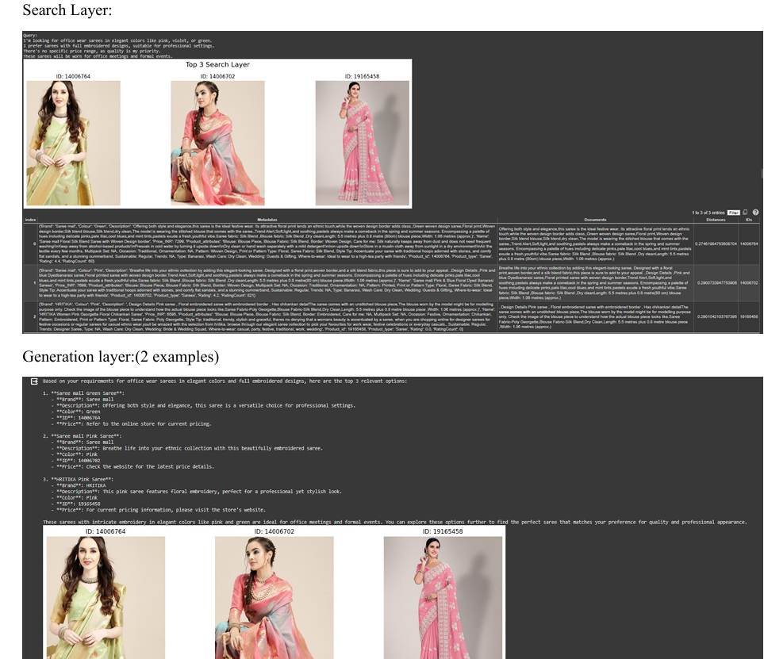
#Query 2: I'm looking for office wear sarees in elegant colors like pink, violet, or green. I prefer sarees with full embroidered designs, suitable for professional settings. There's no specific price range, as quality is my priority. These sarees will be worn for office meetings and formal events.

Slide 9
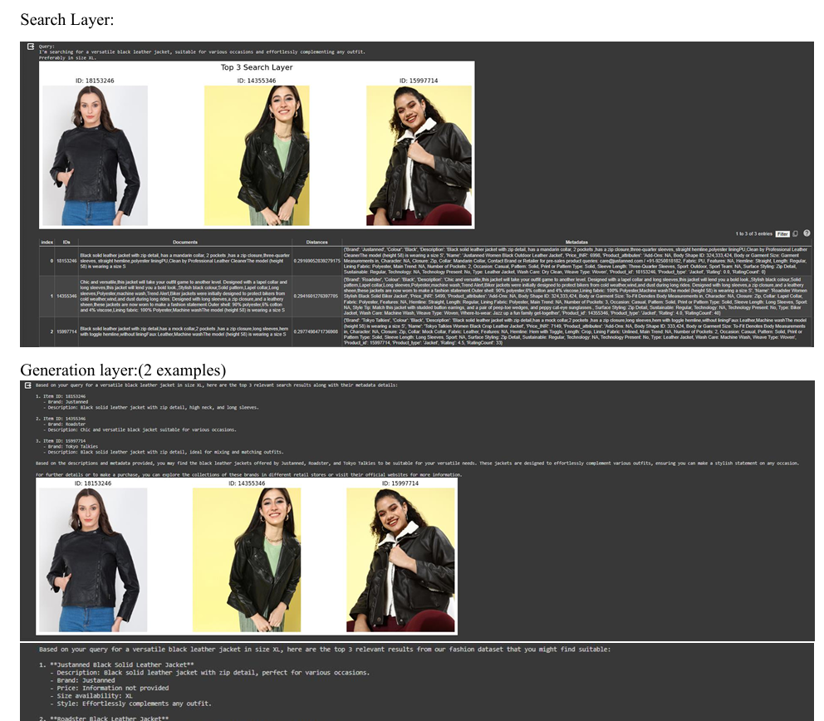
#Query 3: I'm searching for a versatile black leather jacket, suitable for various occasions and effortlessly complementing any outfit. Preferably in size XL.

Slide 10
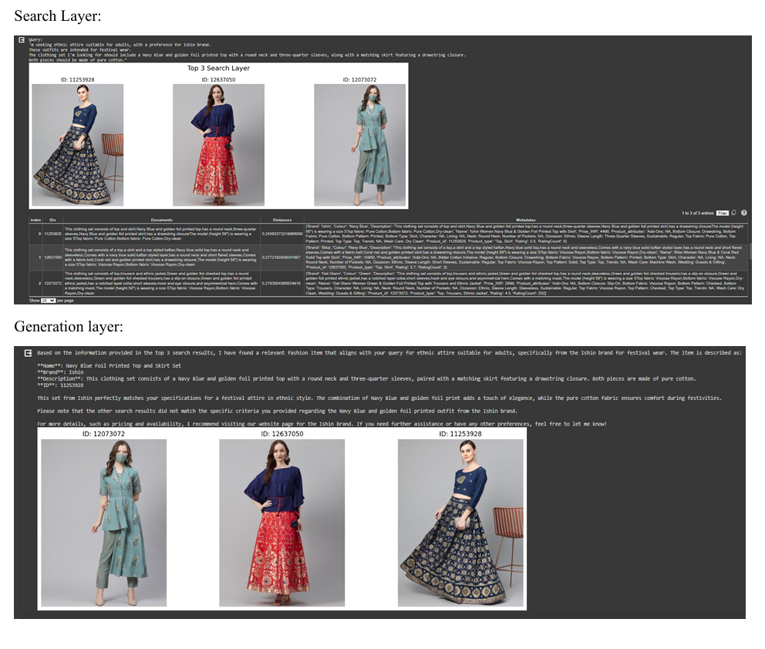
Query 4: "I'm seeking ethnic attire suitable for adults, with a preference for Ishin brand. These outfits are intended for festival wear. The clothing set I'm looking for should include a Navy Blue and golden foil printed top with a round neck and three-quarter sleeves, along with a matching skirt featuring a drawstring closure. Both pieces should be made of pure cotton.

Slide 11
Challenges
Several challenges were encountered during the implementation process: Metadata Processing: Initially, there were issues with processing metadata, which affected the display of results. This was resolved through debugging and refining the metadata processing code. Dataset Chunking: Loading the entire dataset without chunking posed a challenge due to memory constraints. However, chunking was not implemented due to time constraints and the manageable size of the dataset.

Slide 12
Lessons Learned
Proper data preprocessing is crucial for ensuring data quality and readability. Integrating advanced AI models can significantly enhance the system's capabilities in generating detailed and contextually relevant responses. Handling large datasets requires careful consideration of memory constraints and implementation of efficient data processing techniques.

Slide 13
Future Scope
As a future scope, the project can be extended by implementing it as a Flask web application and hosting it on a website. This would provide better interaction and aesthetics for users. Additionally, rephrasing prompts and introducing interactive sessions with criteria-based filters could further enhance the system's performance and user experience.

Slide 14
Conclusion
Upon comparison of the search query outcomes from both the search and generation layers, it becomes apparent that the generation layer produces more detailed and comprehensible results. While the search layer retrieves relevant information through keyword matching or set criteria, the generation layer utilizes advanced AI models like GPT-3.5 to dynamically generate responses, incorporating context and furnishing tailored and informative answers. The generation layer's capability to comprehend query context and furnish responses in natural language enhances overall readability and user engagement. Its flexibility allows it to adapt to various query formats and provide customized responses, catering to diverse user preferences. This versatility makes it a valuable tool for tasks necessitating comprehensive understanding and communication of information. In summary, while the search layer efficiently retrieves relevant information, the generation layer significantly enhances output quality and readability, making it a preferred choice for tasks requiring detailed and user-friendly responses.

